Slide 1
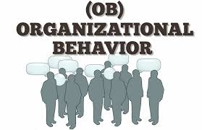
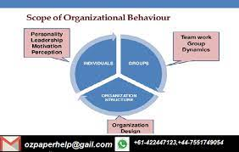
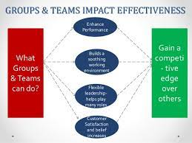
Group Behavior

Slide 2
Work Teams
A work team refers to a group whose individual efforts result in a far more outstanding performance than the sum of the separate inputs.
Work teams ensure that joint efforts have been achieved to achieve a task that would otherwise be complicated for an individual.
Safwan Company teamwork is effectively anchored on the following characteristics: but not limited to precise aim, honest and open communication, clearly defined obligations, similar goals, upholding of different views and transparency, and accountability.
In deciding when to use an individual instead of a group, the Company applies three tests, whether the work is complex, whether the work is simple and do not need diverse input and lastly, wherever using the members of the groups are interdependent.
The Company makes team skills one of the core interpersonal skills during the recruitment process; Induction where the employees learn various skills.
Finally, through reward where the Company encourages employees to work together, and their efforts are rewarded
Notes:
There is a notable difference between a group and a team. Teams are very interdependent, performing their acts to emphasize each other's strengths and complete a common goal. On the other hand, the groups use personal efforts to have the work done, and members pay attention to their objectives (Schecter, et al., 2018). The Company has the five-team arrangements, which are the functional team that is permanent. A cross-functional team that is comprised of members drawn from different departments. The Matrix team involves the boss system and finally the outsourced team on a contractual basis that plays a vital role in peak seasons.

Slide 3
Power and Politics
Power refers to the force that originates from the top and cascades down.
Leadership refers, on the other hand, to come from down and goes upwards to the top.
In the Safwan Company, one is made a leader from a particular department. Safwan Company Applies the three forms of formal powers: the Reward power, legitimate power, and the Coercive power.
The Company further employs the bases of personal power, which are expert power and Referent power.
To have the Company fully understand its objectives, it relies on the dependency theory, which increases when there are no options and that employees should interact with the boss to get what they want.
Humbly put, with organizational politics, persons associate themselves with others to triumph over the rare possessions
. Power corrupt since most leaders become overconfident in decision-making and often than not tend to assume and ignore their juniors.
Notes:
The power leads to some leaders harass their employees sexually and discriminate against those they think disagree with them. To address the above, Safwan Company has come up with a sexual policy detailing how all employees should conduct themselves. The steps and actions of persons indicted of sexual harassment are well laid out.

Slide 4
Communication
Communication is the art that ensures that the employee and the management are in the same position in terms of delivery and attaining the organization's goals.
Safwan Company appreciates that communication refers to the basis for the growth and survival of organizations.
It refers to the process of founding and sharing views among the people in reaching a common understanding.
Channel richness relates to communication channel choice since it permits the information to be transmitted with immediate feedback.
. In overcoming the cultural barriers, the Company has devised knowledge sharing, diversity training and ensuring that clear and polite commination has been embraced.
Notes:
Non-verbal communication is widely used in the Company, which involves emphasis or intonations that all employees should be well conversant with
Over the years, the Company has realized that there are some barriers to effective communication that can halt the Company w which are conflict in work, inability to listen to one another, lack of transparency, and trust.
. The body language conveys status, level of engagement and emotional state. Important to note on Channel richness and choice of communication channel depends on whether the message is routine. The Safwan Company's manager is always encouraged always to strive to obtain feedback from their juniors and note that the communication mode partly determines communication effectiveness.

Slide 5
Leadership
The success of Safwan Company has been there due to good leadership and the application of best theories.
The trait theory has been well utilized as it proved that leadership is inborn and linked to personal qualities.
Under the behavioral approaches, Trait research provides a basis for selecting the right people for leadership. ­
Behavioral theories of leadership, in contrast, imply we can train people to be leaders.
The encounters of management are three kinds: external, coming from people and situations; internal, stemming from within the leader himself; and those arising from the nature of the leadership role.
Worth noting is that leaders who possess specific traits and demonstrate culturally proper consideration and structuring conduct look more efficient.
. Effective leadership can be manifested through emotional intelligence on how leaders respond to particular issues that arise when not expected

Slide 6
Foundations of Organizational Structure
Safwan Company has several organizational structures: the design job, departmentalization, established report relations, distribution power, activities organization, and the specific positions.
. The team structure removes the chain of expertise and substitutes departments with enabled groups.
Removes vertical and horizontal boundaries.
Breaks down outside barricades in the circular form: in the center are the managers, and shining external in rings clustered by purpose are the managers, then the experts, then the employees.
Downsizing is a systematic work to make an organization slenderer by selling off business units, closing locations, or reducing staff.
The chain of command from the top leadership is well defined, and thus, there is no duplication of roles since every employee is designed his or her functions.

